Slide 1
How to analyse our DNA?
Barbora Miksatkova Radina Nikolova Tiberiu Dima
Supervisors:
Dr. E. Kravchenko
A. Rusakovich
Dzhelepov Laboratory of Nuclear Problems (DLNP)

Slide 2
Aims of the project
analysis of human DNA using PCR and RT-PCR
determination of disease and allergy predispositions
determination of mitochondrial DNA sequence

Slide 3
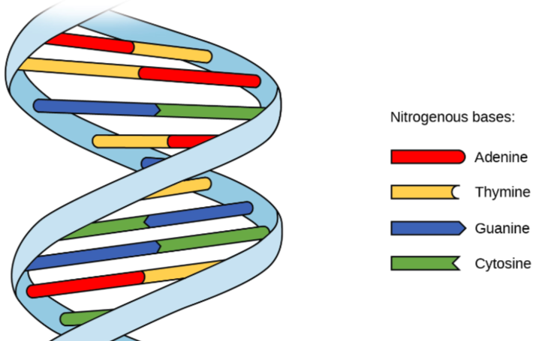
DNA
deoxyribonucleic acid
carrier of genetic information
the structure was identified by Watson and Crick in 1953
double helix
A, C, G, T

Slide 4
DNA isolation
DNA isolation from buccal epithelium
PCR

Slide 5
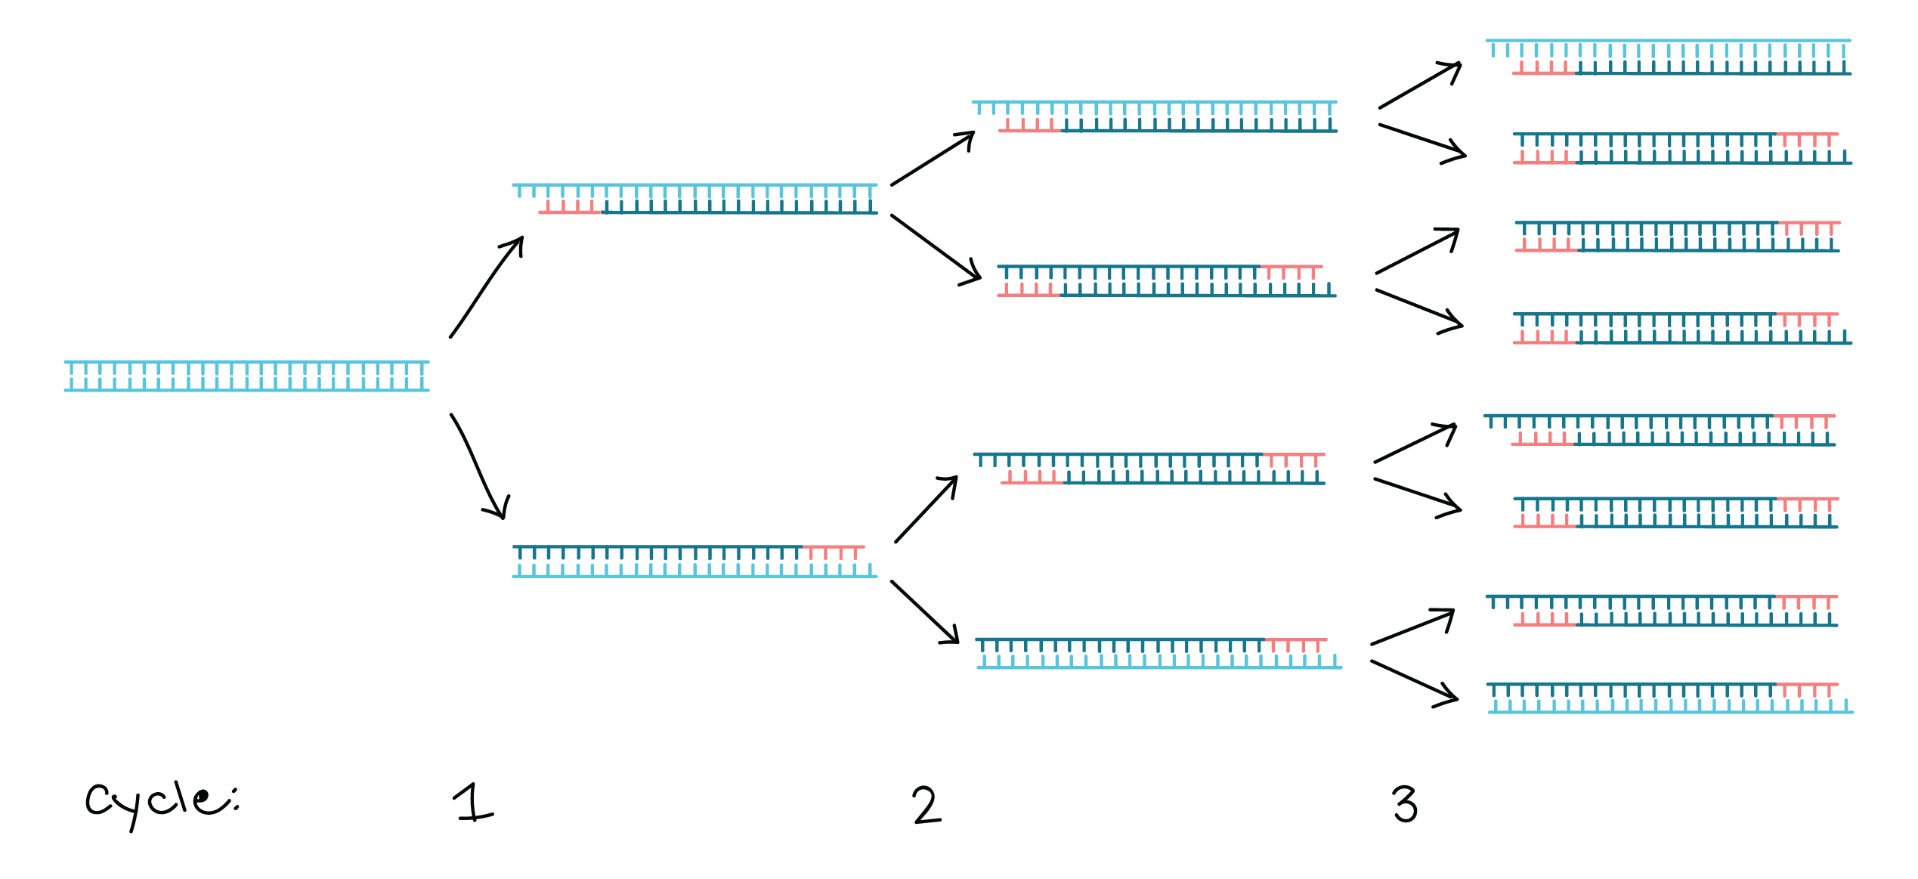
PCR
polymerase chain reaction
rapid method for DNA amplification
creates up to 1 billion copies of DNA target
segment for 30 cycles

Slide 6
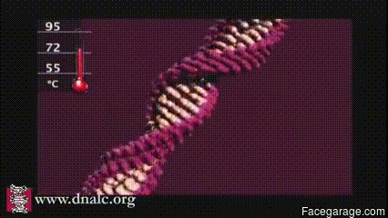
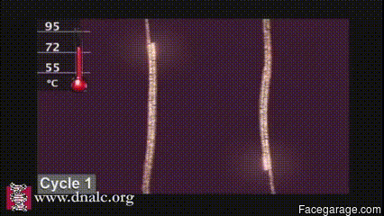
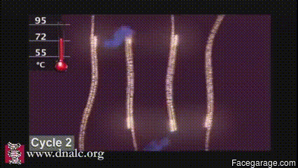
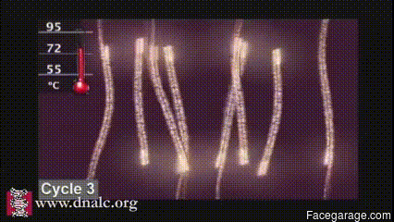
PCR

Slide 7
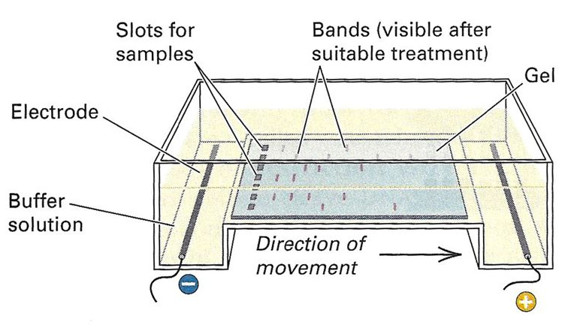
Gel electrophoresis
method for separation and analysis of macromolecules
DNA, RNA, proteins
separation takes place on an agarose gel
applied electric field moves ⊝ charged molecules to anode and ⊕ charged molecules to cathode
shorter molecules move faster and migrate farther than longer ones

Slide 8
Gel electrophoresis

Slide 9
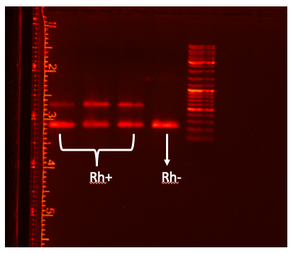
Rh factor test
Rh is part of a blood group system
important for the normal course of pregnancy
test indicates whether the person is Rh positive (heterozygous) or Rh negative (homozygous)

Slide 10
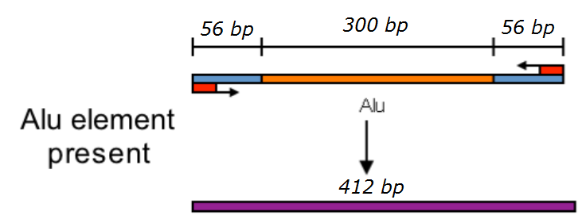
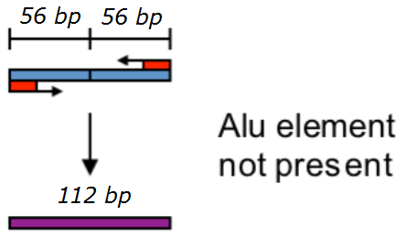
Cardiovascular disease test
Alu – ca. 300 bp length Short INterspersed Element – Alu (Arthrobacter luteus (Alu) restriction endonuclease, approx. 10% of Human Genome = 1 million copies). Notable insertion in chromosome #8 locus TPA-25 (TPA enzyme dissolves blood clots): dimorphic (yes in some, no in other individuals).
PCR sequence amplification

Slide 11
Cardiovascular disease test
Agarose gel electrophoresis – separation 412 bp vs. 112 bp fragments
Results
– homozygous w/out Alu is of high risk for cardio-vascular disease
– heterozygous w/ + w/out Alu is of medium risk for cardio-vascular disease
– homozygous w/ Alu is of low risk for cardio-vascular disease
homozygous
heterozygous

Slide 12
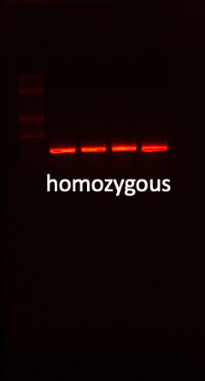
HIV resistance test
CCR5 – Δ32 – allele of CCR5 gene (role in inflamatory response to infection), 32 bp deletion introducing premature stop codon in CCR5 locus => non-functional receptor. … but M-tropic HIV requires functional CCR5.
homozygous for CCR5 – Δ32 do not express functional CCR5 receptors => … immune to HIV-1
Results
– all individuals displayed a functional CCR5
homozygousity

Slide 13
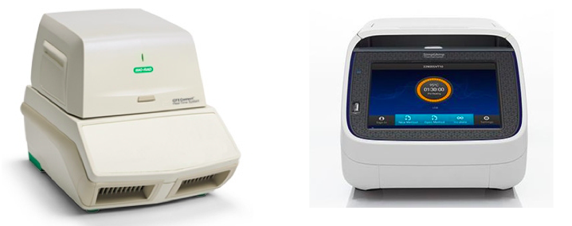
Real Time PCR vs Regular PCR
Real Time PCR (or RT-PCR) monitors DNA amplification in real time with the help of binding fluorescence to the DNA strands
RT-PCR can be used to amplify different sequences in the same solution using different fluorescent solutions (i.e FAM and Rox)
A disadvantage of RT-PCR is that it’s more expensive to operate and buy than traditional PCR, but it’s more precise and requires better quality (concentration) of DNA

Slide 14
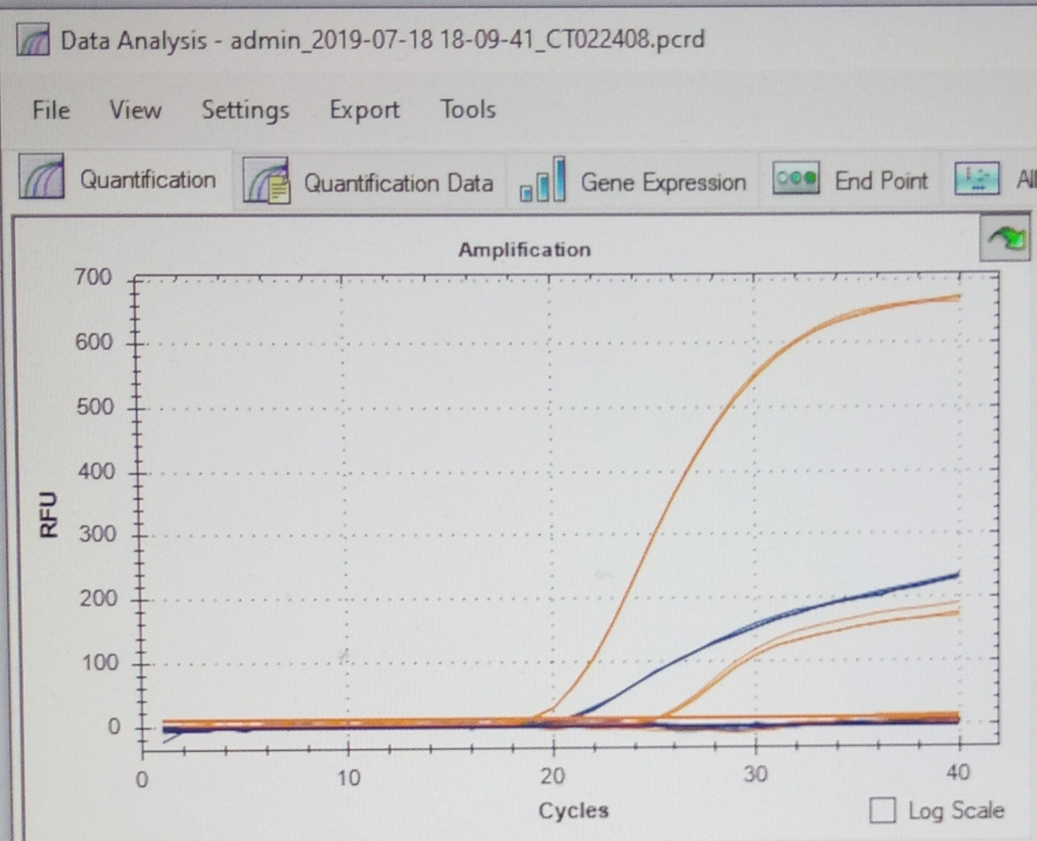
Oxytocine test system
OXT – high level plasma oxytocin => assoc. w/ enhanced sociality
OXTR – receptor gene @ 3p25 chrms
RT-PCR – analysis of fluorescent genes embeded to evidentiate the A / G allele presence
heterozygous
Results
– the observed split in RT-PCR reproduction of the samples indicates the heterozygousity of the individual => … presence of both A / G alleles, denoting an ambivalent personality, both inner / outer-oriented.

Slide 15
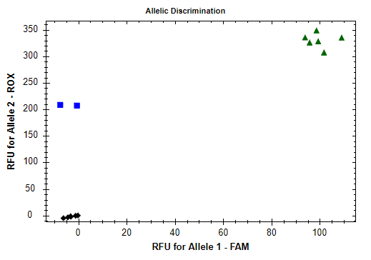
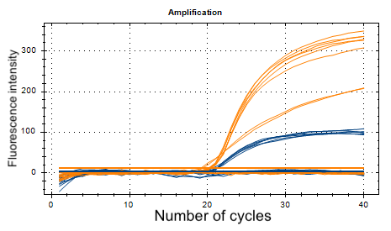
Allergy test system
shows if a person is likely to have an allergy and to be resistant to parasitic diseases at the same time
IgE plays important role in the development of allergies and other diseases
heterozygous
moderate allergy risk
homozygous
high allergy risk
control

Slide 16
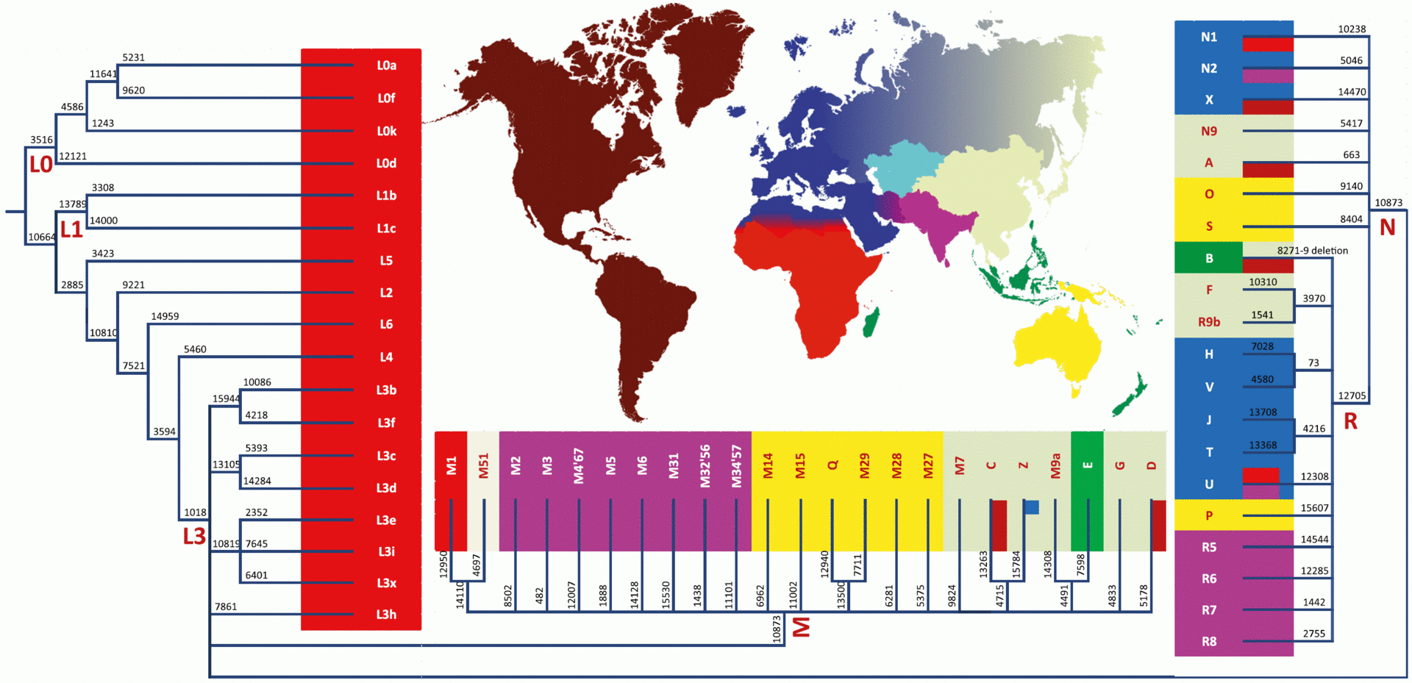
Mitochondrial DNA
mtDNA can be used for determination of person's place of origin

Slide 17
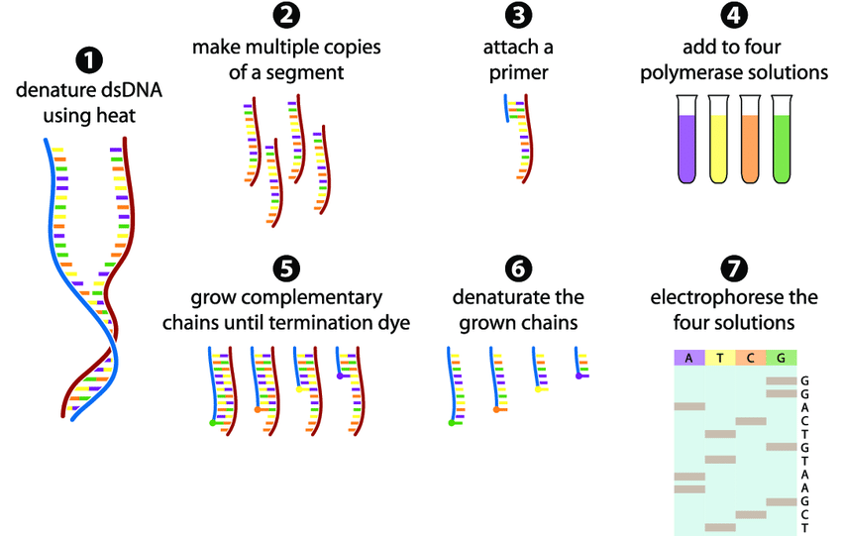
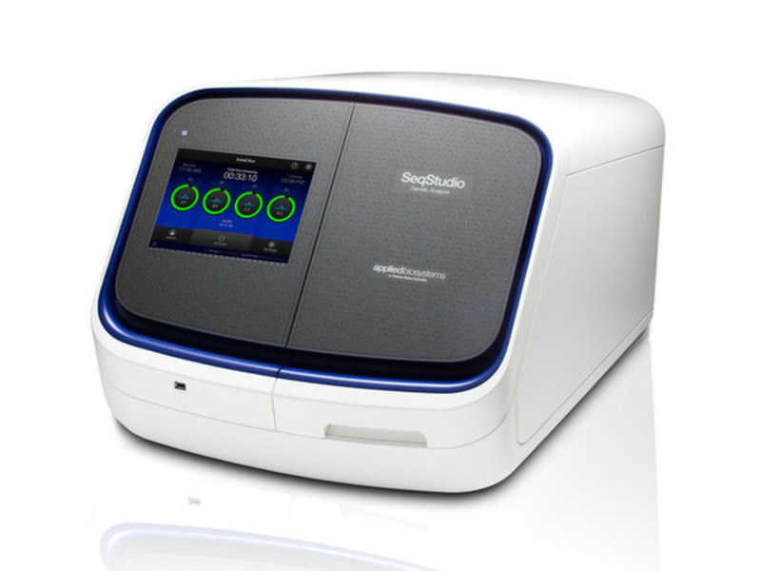
DNA Sequencing
determining the order of nucleotides (A T C G) in DNA
knowing of the sequence is important in biological research, biotechnology, medical diagnostics, etc.
Sanger sequencing

Slide 18
Sequencing results
www.mitomap.org
you can determine your haplogroup

Slide 19
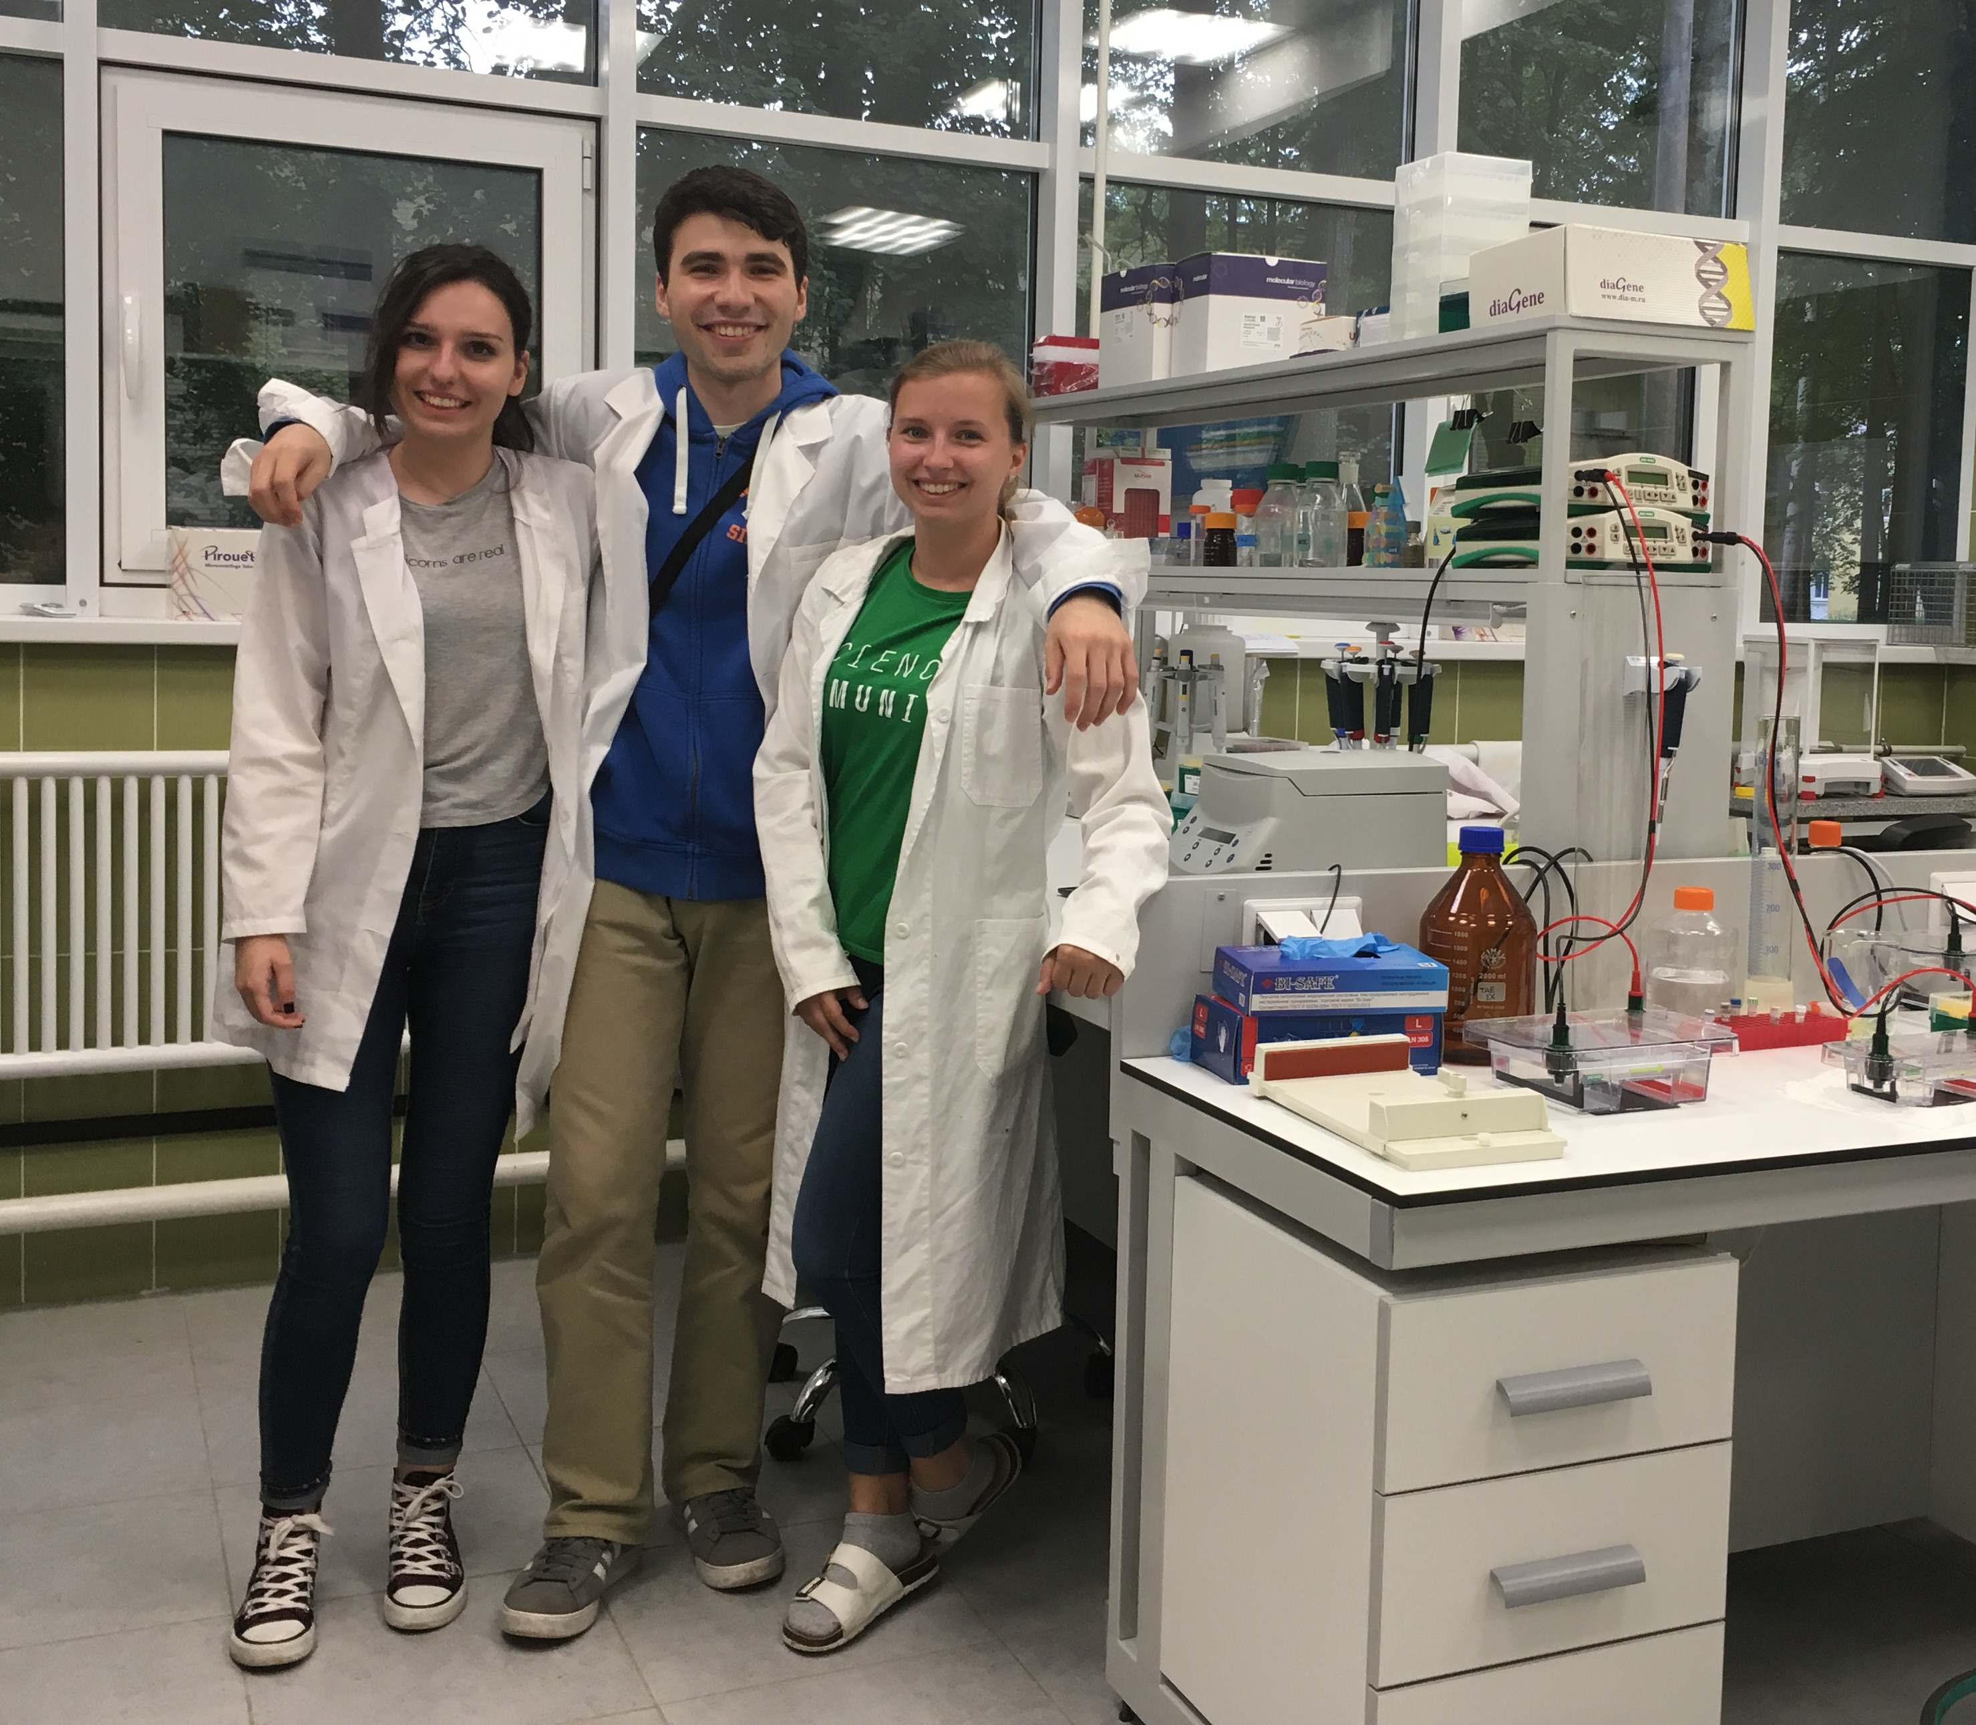
Thank you for your attention!

